Slide 1
Welcome Agile Software Quality Management
Attributes testing → Better quality, less risk

Slide 2
Agile Software Quality Management
My goal is to bring the QA and Agile communities closer for the benefit of both.
Success criteria / Metric: Some of you will try ASQM…
…and share your results with #PNSQC and #AONW.

Slide 3
ASQM
Part 1
ASQM defined.
Operational definition of “quality”
ASQM test matrices
ASQM test/risk matrices
Notes:
Now that we have a way of sufficiently describing how we are going to test, we can move on to the Iron Triangle.

Slide 4
Agile Software Quality Management
ASQM is attributes testing for software:
We cannot and need not test everything [availability].
An agile way to focus software cycles [coherence].
Testing is directly related to risk. [profitability]
Higher risk → More testing
Lower risk → Less testing
What is a thing other than some function of its attributes?

Slide 5
Agile Software Quality Management
May work best with very small cycles. (y = f(x)dx sort of stuff)
SEI: (Barbacci 2003) “The larger the project, the more likely it will be late due to quality problems…”
IES: As cycle time approaches zero, the risk associated with other qualities also approaches zero.

Slide 6
What is “quality”?
My operational definition of “quality”:
quality = f (q1, q2, …, qN) in context
That is, quality is some function of the important product qualities* in your context. It changes from cycle to cycle.
* This presentation uses these terms interchangeably: qualities, attributes, properties, characteristics.
“Software quality is the degree to which software possesses a desired combination of attributes.” – IEEE std 1061
Notes:
Crosby “Quality is conformance to requirements.”
Juran “Fitness for use”
Deming <not a valid question> Quality is defined by how well the management team plans, implements, and makes improvements in products and projects.
Me: Quality is some function of salient product attributes in context.

Slide 7
What then is ASQM?
Agile Software Quality Management is a software change approach that challenges teams to…
choose the important qualities* and
manage significant risks.
It is context-sensitive, scalable, understandable, portable, affordable, available, …
* IEEE has a list of 85 or more quality attributes. See also ISO/IEC 25010:2011.
Notes:
So if THAT is quality, what is ASQM?

Slide 8
Why do we need ASQM?
We cannot test everything. So to reduce risk:
ASQM focuses effort on the important qualities while monitoring risk.
And it expands the team to include important, non-technical people:
finance,
general management,
marketing, and others.
Notes:
ASQM provides:
An operational definition of quality
An expanded test matrix
A marriage of formerly estranged project variables (scope, schedule, cost)
Support for short cycle times / frequent delivery

Slide 9
Why do we need ASQM?
POP QUIZ
Why should a Finance person be on the software team?
Notes:
ASQM provides:
An operational definition of quality
An expanded test matrix
A marriage of formerly estranged project variables (scope, schedule, cost)
Support for short cycle times / frequent delivery

Slide 10
How do we use ASQM?
At the beginning of a cycle, the team:
Selects salient quality attribute(s)
Lists associated questions and answers
Ranks important risks
Plans for monitoring those risks

Slide 11
ASQM test matrix*
Quality | Question | Metric
Most important attribute, property, characteristic | What do we need to know about it? | What data will answer the question(s)?
Second most important attribute
Next most important attribute…
* An adaptation of Victor Basili's Goal-Question-Metric and Robert Grady's FURPS
Notes:
GQM
FURPS is Functionality, Usability, Reliability, Performance, and Supportability
I added the Method.
Rebecca Wirfs-Brock added the landing zones.
This matrix expands to include the most important qualities for your project and contracts for focused iterations.

Slide 12
ASQM test matrix
Quality | Question | Metric
Most important attribute, property, characteristic | What do we need to know about it? | What data will answer the question(s)?
Second most important attribute
Next most important attribute…
Method
When, where, and how we get the data
My small addition
Notes:
GQM
FURPS is Functionality, Usability, Reliability, Performance, and Supportability
I added the Method.
Rebecca Wirfs-Brock added the landing zones.
This matrix expands to include the most important qualities for your project and contracts for focused iterations.

Slide 13
ASQM test matrix
Quality | Question | Metric
Most important attribute, property, characteristic | What do we need to know about it? | What data will answer the question(s)?
Second most important attribute
Next most important attribute…
Method
When, where, and how we get the data
Limits
Landing zone for each attribute (Sufficient but not gold-plated)
Rebecca Wirfs-Brock
& Ray Arell’s significant addition
Notes:
GQM
FURPS is Functionality, Usability, Reliability, Performance, and Supportability
I added the Method.
Rebecca Wirfs-Brock added the landing zones.
This matrix expands to include the most important qualities for your project and contracts for focused iterations.

Slide 14
ASQM test matrix – general form
Quality | Question | Metric
Most important attribute, property, characteristic | What do we need to know about it? | What data will answer the question(s)?
Second most important attribute
Next most important attribute…
Method
When, where, and how we get the data
Limits
Landing zone for each attribute (Sufficient but not gold-plated)
Notes:
GQM
FURPS is Functionality, Usability, Reliability, Performance, and Supportability
I added the Method.
Rebecca Wirfs-Brock added the landing zones.
This matrix expands to include the most important qualities for your project and contracts for focused iterations.

Slide 15
ASQM test matrix – general form
Quality | Question | Metric
Most important attribute, property, characteristic | What do we need to know about it? | What data will answer the question(s)?
Second most important attribute
Next most important attribute…
Method
When, where, and how we get the data
Limits
Landing zone for each attribute (Sufficient but not gold-plated)
What is important?
A: Context driven.
When do we stop?
A: Context driven.
Decide with your teammates!
Notes:
GQM
FURPS is Functionality, Usability, Reliability, Performance, and Supportability
I added the Method.
Rebecca Wirfs-Brock added the landing zones.
This matrix expands to include the most important qualities for your project and contracts for focused iterations.

Slide 16
A sample ASQM test matrix
Quality | Question | Metric | Method | Limits
Capability | Does it work? Is it all there? | #bugs (weighted) Bug density %FP or story points delivered | Bug tracking #bugs/KLOC [See IFPUG] | 0 – 50 0 – 10 50% - 95%
Security | Hackable? Robust? Resilient? | #vulnerabilities Exposed PII Uncaught crashes | Static analysis Pen testing Fuzzing | 0 null dereferences 0 PII leaks 0 uncaught crashes
Maintainability | Understandable? Changeable? Brittleness | Cyclomatic complexity Mins / typical fix #New bugs / change | Static analysis Change tracking Bug tracking | 1 < CC < 10 1 – 30 minutes 0 – 1 / change
Supportability | Explainable? | Customer satisfaction | Surveys | T2B 50 - 80
Notes:
These are fictitious data… simply for illustration purposes
Notice how the column headers change when dealing with less significant qualities (below the cut line)
Notice also the budget for failure. It’s not like every risk results in failure, but some will, and the failure budget provides necessary funding.
T2B btw means “top 2 boxes” on user surveys e.g. 9 and 10 on a 1-10 ranking.
And that’s all there is to Part 1: Prioritizing your qualities and taking risks

Slide 17
ASQM of RISK
Why do we test?
Tester: “To find bugs and protect the user”
Business owner: “To manage risk”
Some things are not worth testing.
Tabs vs spaces? Who cares? Maintenance engineers
Size of executable? Nobody will ever need 640K RAM
Notes:
Now that we have a way of sufficiently describing how we are going to test, we can move on to the Iron Triangle.

Slide 18
ASQM test/risk matrix general form
Quality | Question | Metric | Method | Limits
Most important attribute, property, characteristic | What do we need to know about it? | What data will answer the question(s)? | When, where, and how we get the data | Landing zone for each attribute (Sufficient but not gold-plated)
Second most important attribute
Next most important attribute…
 |  | (Cut line)
Most risky attribute | What is the risk? | Probability? Impact? (money) | Mitigation? Trigger? | Failure budget
Second most risky attribute…
Notes:
GQM
FURPS is Functionality, Usability, Reliability, Performance, and Supportability
I added the Method.
Rebecca Wirfs-Brock added the landing zones.
This matrix expands to include the most important qualities for your project and contracts for focused iterations.

Slide 19
A sample ASQM test/risk matrix
Quality | Question | Metric | Method | Limits
Capability | Does it work? Is it all there? | #bugs (weighted) Bug density %FP or story points delivered | Bug tracking #bugs/KLOC [See IFPUG] | 0 – 50 0 – 10 50% - 95%
Security | Hackable? Robust? Resilient? | #vulnerabilities Exposed PII Uncaught crashes | Static analysis Pen testing Fuzzing | 0 null dereferences 0 PII leaks 0 uncaught crashes
Maintainability | Understandable? Changeable? Brittleness | Cyclomatic complexity Mins / typical fix #New bugs / change | Static analysis Change tracking Bug tracking | 1 < CC < 10 1 – 30 minutes 0 – 1 / change
Supportability | Explainable? | Customer satisfaction | Surveys | T2B 50 - 80
(Cut line) | What’s the risk? | Risk factors | Mitigation / Trigger | Failure budget
Availability | Too much downtime | Probability = 20% Impact = $100K | Refunds / High returns | $20K
Affordability… | Slow sales in Q4 | Probability = 10% Impact = $150K | Early adopter discounts / Direct feedback | $15K
Notes:
These are fictitious data… simply for illustration purposes
Notice how the column headers change when dealing with less significant qualities (below the cut line)
Notice also the budget for failure. It’s not like every risk results in failure, but some will, and the failure budget provides necessary funding.
T2B btw means “top 2 boxes” on user surveys e.g. 9 and 10 on a 1-10 ranking.
And that’s all there is to Part 1: Prioritizing your qualities and taking risks

Slide 20
Part 1 Summary
ASQM
…is a management framework sensitive to local conditions.
…defines “quality” as a function of salient attributes in context.
…favors shorter cycles.
…supports defensible test plans and risk assessments.
…supports continual improvement → a culture of quality.
…takes GUTS (good unit tests).

Slide 21
ASQM
Part 2
Iron Triangle demise: Project constraints are product variables, too.
Notes:
Now that we have a way of sufficiently describing how we are going to test, we can move on to the Iron Triangle.

Slide 22
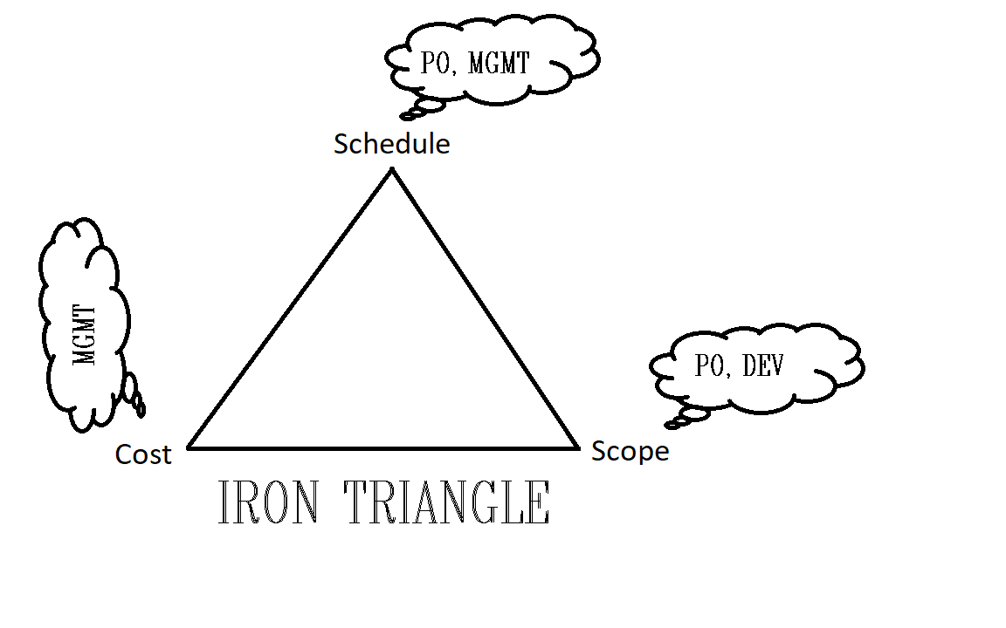
What about the pesky project constraints?*
* And the silos they sustain?
Notes:
Scope Schedule and Cost – the three amigos that everyone hates. They tear at one another until something finally limps out the door.

Slide 23
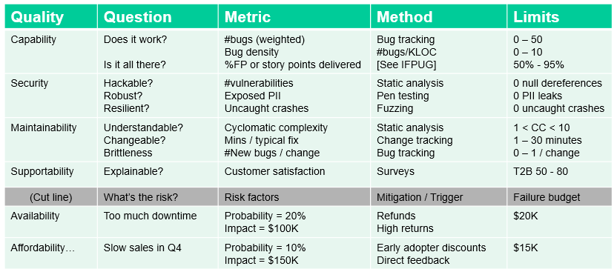
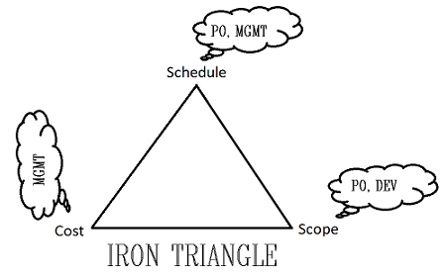
How to reconcile?
Notes:
How to reconcile these project variables with the now highly-defined product qualities? Can we?

Slide 24
Can we normalize the project variables?
Notes:
If only there was some way or merging these sets of variables…

Slide 25
Project constraints → Product qualities
Schedule → Availability
Scope → Capability
Cost → Affordability
Magic happens!
The death of software projects?
#NoProjects
Notes:
I suggest that these project constraints are really product qualities in disguise.
Does that mean we don’t need projects anymore?

Slide 26
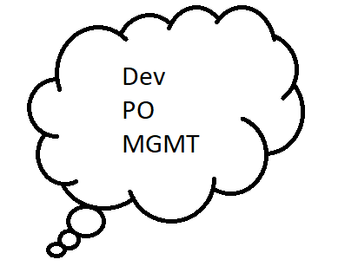
Normalize the project constraints!
Availability ← Schedule
Affordability ← Cost
Capability ← Scope
Notes:
Here’s how to make the Iron Triangle go away, bring the warring factions to the table, and incorporate the project variables into the product qualities:
Redefine Cost as a second class of Affordability (Affordability to the producer)
Redefine Schedule as a second class of Availability (Availability to the market) and
Merge Scope with Capability.

Slide 27
A normalized ASQM test/risk matrix
Quality | Question | Metric | Method | Limits
Availability (int) | When can we sell it? When can we ship it? | Date for marketing material Dates for GA | Monitor go-to-market stuff Monitor velocity | July 4th–Labor Day Labor Day – T. Day
Affordability (int) | Does it cost too much to develop? | Fully-loaded labor cost X number of staff | HR and Engineering headcount and pay data | $2M – $4M
Capability (mrkt) | Does it meet market expectations? | #beta users #early orders | Direct customer feedback Monitoring pre-sales | “cool” – “wow” 20 – 50
Capability | Does it work? Is it all there? | #bugs (weighted) Bug density %FP or story points delivered | Bug tracking #bugs/KLOC [See IFPUG] | 0 – 50 0 – 10 50% - 95%
Security | Hackable? Robust? Resilient? | #vulnerabilities Exposed PII Uncaught crashes | Static analysis Pen testing Fuzzing | 0 null dereferences 0 PII leaks 0 uncaught crashes
Maintainability | Understandable? Changeable? Brittleness | Cyclomatic complexity Mins / typical fix #New bugs / change | Static analysis Change tracking Bug tracking | 1 < CC < 10 1 – 30 minutes 0 – 1 / change
Supportability | Explainable? | Customer satisfaction | Surveys | T2B 50 - 80
(Cut line) | What’s the risk? | Risk factors | Mitigation / Trigger | Failure budget
Availability | Too much downtime | Probability = 20% Impact = $100K | Refunds High returns | $20K
Affordability… | Slow sales in Q4 | Probability = 10% Impact = $150K | Early adopter discounts Direct feedback | $15K
Notes:
Added the first three rows. Yes, they are above the others… a deferential treatment of management. Warning, this may set a bad precedent.
GA means general availability.
Notice Availability has an internal measurement and an external measurement. Same with Affordability. These are separate and can be managed separately.

Slide 28
Part 2 Summary
“Project constraints” are not constraints at all
They can be normalized (ala data normalization)
Cost → affordability
Schedule → availability
Scope → capability (feature/functions)
This brings management and PO/PM to the table, speaking the same language
help!
Notes:
If we cannot test everything, what do we test? That is completely context-sensitive.
Your application domain, your customer set, your business plans and models, and especially your delivery speed, those things drive your quality planning / risk management.
Soooo, you put these quality attributes in a little matrix – a ASQM test matrix

Slide 29
ASQM
Part 3
Flow stuff: Smaller increments are better
Notes:
Scaling goes both ways. What other project-level requirements and artifacts are unnecessary in continuous flow shops?
What

Slide 30
Scaling goes both ways
SAFe® is one way to scale up
Well-defined interfaces for multi-team projects
Many implementation details
What happens when we scale down?
Fewer things change, less code churn
Better communication between humans
At a certain point, the work begins to flow evenly
Fewer work-in-progress items
Fewer queues
Notes:
Scaling goes both ways. What other project-level requirements and artifacts are unnecessary in continuous flow shops?
What

Slide 31
Tale of Three Teams
Project B.I.G.
Lots of specialization, lots of changes
SAFe® implementation in progress
Project Middling
Smaller team, smaller scope
Scrum
Flow / Mob programming
Driver, navigator, mobber, anthropologist
Notes:
Scaling goes both ways. What other project-level requirements and artifacts are unnecessary in continuous flow shops?
SAFe implementation is ALWAYS in progress as teams come and go

Slide 32
Tale of Three Teams
Project B.I.G.
Specialization: Lots
Project managers, architects, devs, sales, … CSRs
Change / Churn
Product: Lots
Personnel: Lots
Structure
Proscribed and static
Outcomes: Poor / Mixed
Notes:
Multi-year projects: people come and go, goals change
Highly defined roles
Many interpersonal relationships – communication lines
Lots of churn – in code and team composition
Outcomes: Constantly re-framed by major players

Slide 33
Tale of Three Teams
Project Middling
Specialization: Less
PO’s, “Whole Team”, … CSRs
Change / Churn
Product: Bounded by stories and time
Personnel: Little
Structure
Proscribed and static… until Retrospective
Outcomes: Better
Notes:
Project Middling is a series of predefined sprints that can be revised after each sprint.
Senior management has a “good enough” understanding of project objects to authorized / fund the work.
But B.I.G. structures are still there.

Slide 34
Tale of Three Teams
Flow / Mob programming
Specialization: Little
Rotating driver
Many other pairs of eyes tending to related attributes
Change / Churn
Product: One at a time
Personnel: → 0
Structure
Fluid, adaptive
Outcomes: Very good. Zero bugs.
Notes:
Shops in FLOW have no projects per se. They have prioritized changes that are implemented sequentially. WIP = 1
Flow recognizes the need for slack.
Personnel does not change during a product change

Slide 35
Scaling goes both ways
How many qualities should be assured?
It depends…
Risk / Reward for your context
Regulations
Resources

Slide 36
Scaling down
Long cycles → many attributes to measure
Shorter cycles → fewer attributes to measure
As t→0, few attributes change → less total risk
 | Release schedule | Overall cost | Overall risk | Salient qualities | Results
B.I.G. projects | Years | High | High | Many | Poor/Mixed
Middling | Weeks: 1 or 2 | Moderate | Moderate | Few | Better
Mobbing | Minutes | Low | Low | 1+ | Zero defects
Notes:
Shorter cycles → fewer attributes to measure
Less total risk means less testing required
B.I.G. project needs tons of testing, many problems found, lots of negotiation and compromises, and nobody is really happy.
Middling projects can afford to focus on fewer qualities because the churn is lower.
Mobbing projects with WIP=1 and done with the customer present, get immediate feedback, and everyone is happy.

Slide 37
Other advantages of short cycles
Fewer attributes to qualify → faster delivery
Big upfront planning not needed, less idle time
Direct management involvement is possible
Teams are more productive and happier
Issues are seen and handled in real time
Few large-scale, intractable problems
Notes:
Scaling goes both ways. What other project-level requirements and artifacts are unnecessary in continuous flow shops?
What

Slide 38
Quality tradeoffs
Quality tradeoffs then become common:
“It’s fast and feature-rich, but I cannot afford it.” [performance, capability, affordability]
“It still works, but we cannot change the source code.” [reliability, maintainability]
“If we add more features, our users will love it, but the buyers will revolt.” [usability, marketability]

Slide 39
ASQM recasts quality
With ASQM, quality planning…
precedes coding and
drives engineering with
just enough formality and
shifts focus away from mere functionality.
With ASQM risk management...
you explore and actively manage your risks
your highest priority qualities get measured
your lower priority qualities get monitored
Help!
Notes:
If we cannot test everything, what do we test? That is completely context-sensitive.
Your application domain, your customer set, your business plans and models, and especially your delivery speed, those things drive your quality planning / risk management.
Soooo, you put these quality attributes in a little matrix – a ASQM test matrix

Slide 40
Wrap up and review
Historically, testing focused on functionality
but that is one of many quality attributes
and TDD has unit-level functionality covered [GUTs]
Operational definition of quality:
Q(tot) = f(Q1, Q2, …, Qn) in your context
ASQM:
uses test matrices to consider all salient quality attributes
actively manages risk
provides a framework for comparing qualities
HELP!
Notes:
If we cannot test everything, what do we test? That is completely context-sensitive.
Your application domain, your customer set, your business plans and models, and especially your delivery speed, those things drive your quality planning / risk management.
Soooo, you put these quality attributes in a little matrix – a ASQM test matrix

Slide 41
That’s all folks. ☺
IESavage@yahoo.com
IESavage0000@gmail.com

